Slide 1
Predictive
Analytics
Body Fat Dataset
252 male subjects · 15 variables
Response: Body Fat percentage
13 anthropometric predictors
Benchmark: OLS vs Shrinkage methods
Shrinkage Methods
OLS · Ridge · LASSO · Elastic Net
DROHANASH MAJUMDAR - 704

Slide 2
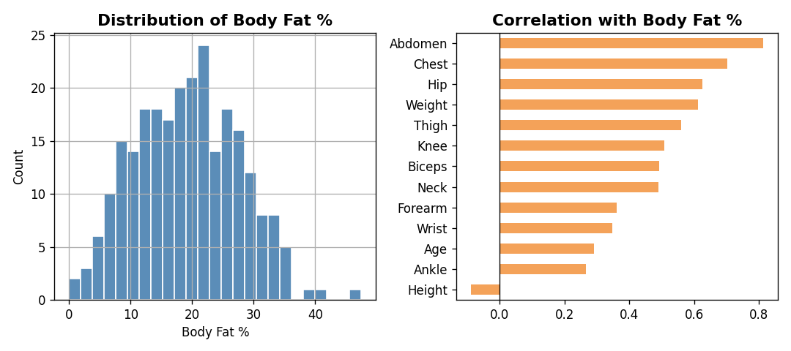
Dataset Overview
252
15
13
0
Observations
Variables
Predictors
Missing Values
Key Variables
EDA: Correlation with Body Fat
Variable | Description
BodyFat | Response – body fat percentage (%)
Abdomen | Abdominal circumference (cm)
Weight | Body weight (lbs)
Age | Age in years
Forearm | Forearm circumference (cm)
Wrist | Wrist circumference (cm)
Abdomen shows the strongest positive correlation with body fat (r ≈ 0.81)

Slide 3
Methodology
1 Data Split
2 Standardisation
3 OLS Baseline
152 training · 100 test observations
Random split (seed=42)
All predictors scaled to mean=0, std=1
Essential for fair penalisation
Ordinary Least Squares — no penalty
Establishes benchmark MSE
4 Ridge (L2)
5 LASSO (L1)
6 Elastic Net
Shrinks coefficients toward zero
λ selected by 10-fold CV
Sets some coefficients exactly to zero
Automatic variable selection
Combines Ridge (L2) + LASSO (L1)
Searches over α and l1_ratio by CV

Slide 4
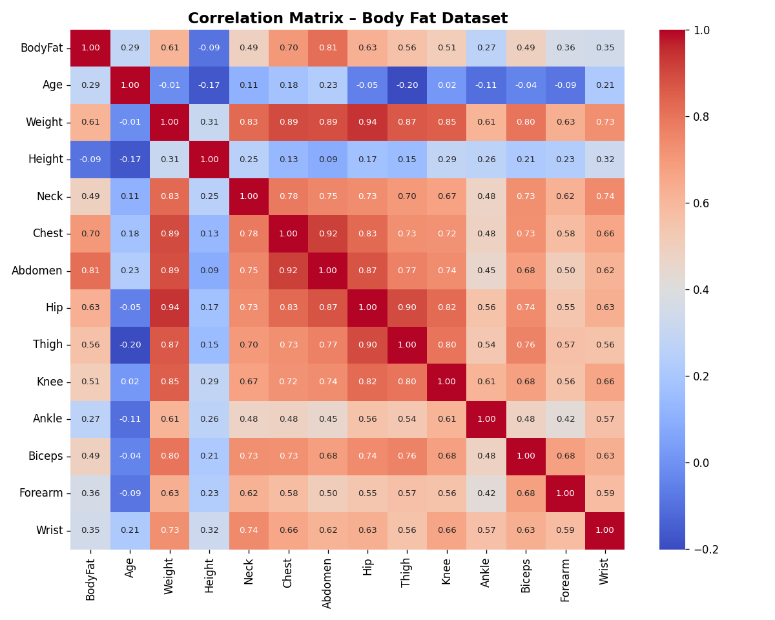
Multicollinearity: Correlation Heatmap
Chest, Abdomen, Hip & Weight are highly intercorrelated (r > 0.8)
Abdomen has the strongest link to BodyFat (r ≈ 0.81)
High multicollinearity inflates OLS coefficient variance
Ridge/LASSO regularisation handles this effectively

Slide 5
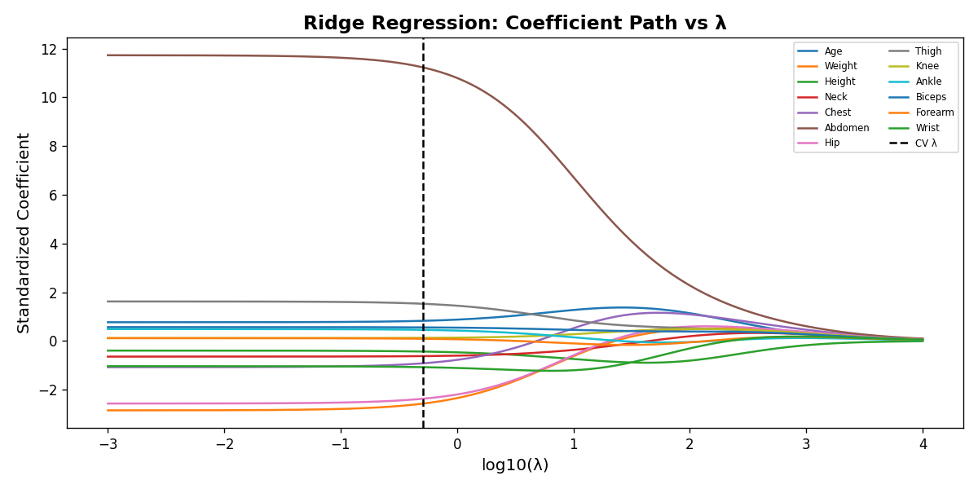
Ridge Regression – Coefficient Path
0.511
Optimal λ
20.98
Test MSE
13 / 13
Predictors
Key Insight: As λ increases, all coefficients shrink toward zero but never reach exactly zero. Ridge retains all predictors — useful when every feature contributes.

Slide 6
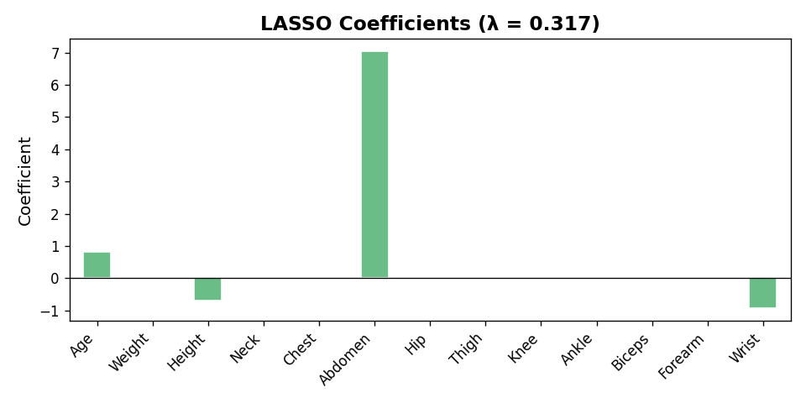
LASSO – Variable Selection
Selected Predictors (λ = 0.317)
✓ Age
✓ Abdomen
✓ Forearm
✓ Wrist
Optimal λ:
0.317
Test MSE:
20.37
Non-zero:
4 / 13
LASSO sets 9 of 13 coefficients to exactly zero → sparse, interpretable model

Slide 7
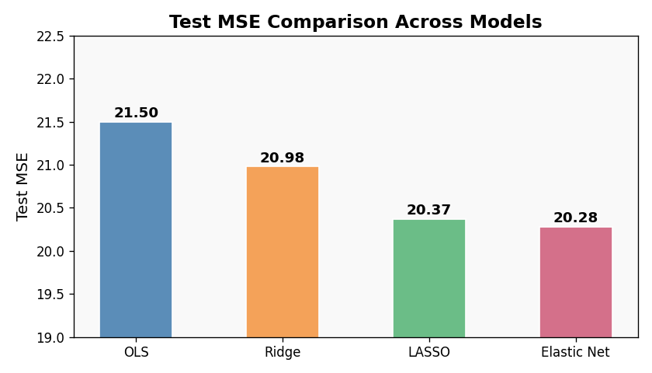
Model Comparison – Test MSE
Model | Test MSE | Non-zero
OLS | 21.50 | 13
Ridge | 20.98 | 13
LASSO | 20.37 | 4
Elastic Net | 20.28 ★ | 4
★ Best model: lowest test MSE
All shrinkage methods outperform plain OLS on unseen data

Slide 8
Elastic Net
Ridge (L2)
LASSO (L1)
Elastic Net
λ = 0.511
l1_ratio = 0
λ = 0.317
l1_ratio = 1
λ = 0.267
l1_ratio = 0.9
No variable
selection
Variable
selection
Variable
selection
All 13
predictors
4 / 13
predictors
4 / 13
predictors
Test MSE:
20.98
Test MSE:
20.37
Test MSE:
20.28 ★

Slide 9
Conclusions
OLS overfit due to multicollinearity — Test MSE of 21.50 was the highest
Ridge (MSE 20.98) improved over OLS by shrinking coefficients but kept all 13 predictors
LASSO (MSE 20.37) selected only 4 predictors: Age, Abdomen, Forearm, Wrist
Elastic Net achieved the best test MSE (20.28) with the same 4 predictors
Abdomen circumference is the single most important predictor of body fat %

